Slide 1

LINFO2992 - TFE
Hasan Bilgin (0446-22-00)
Ruibin Zhang (0660-22-00)
2023-2024

Slide 2
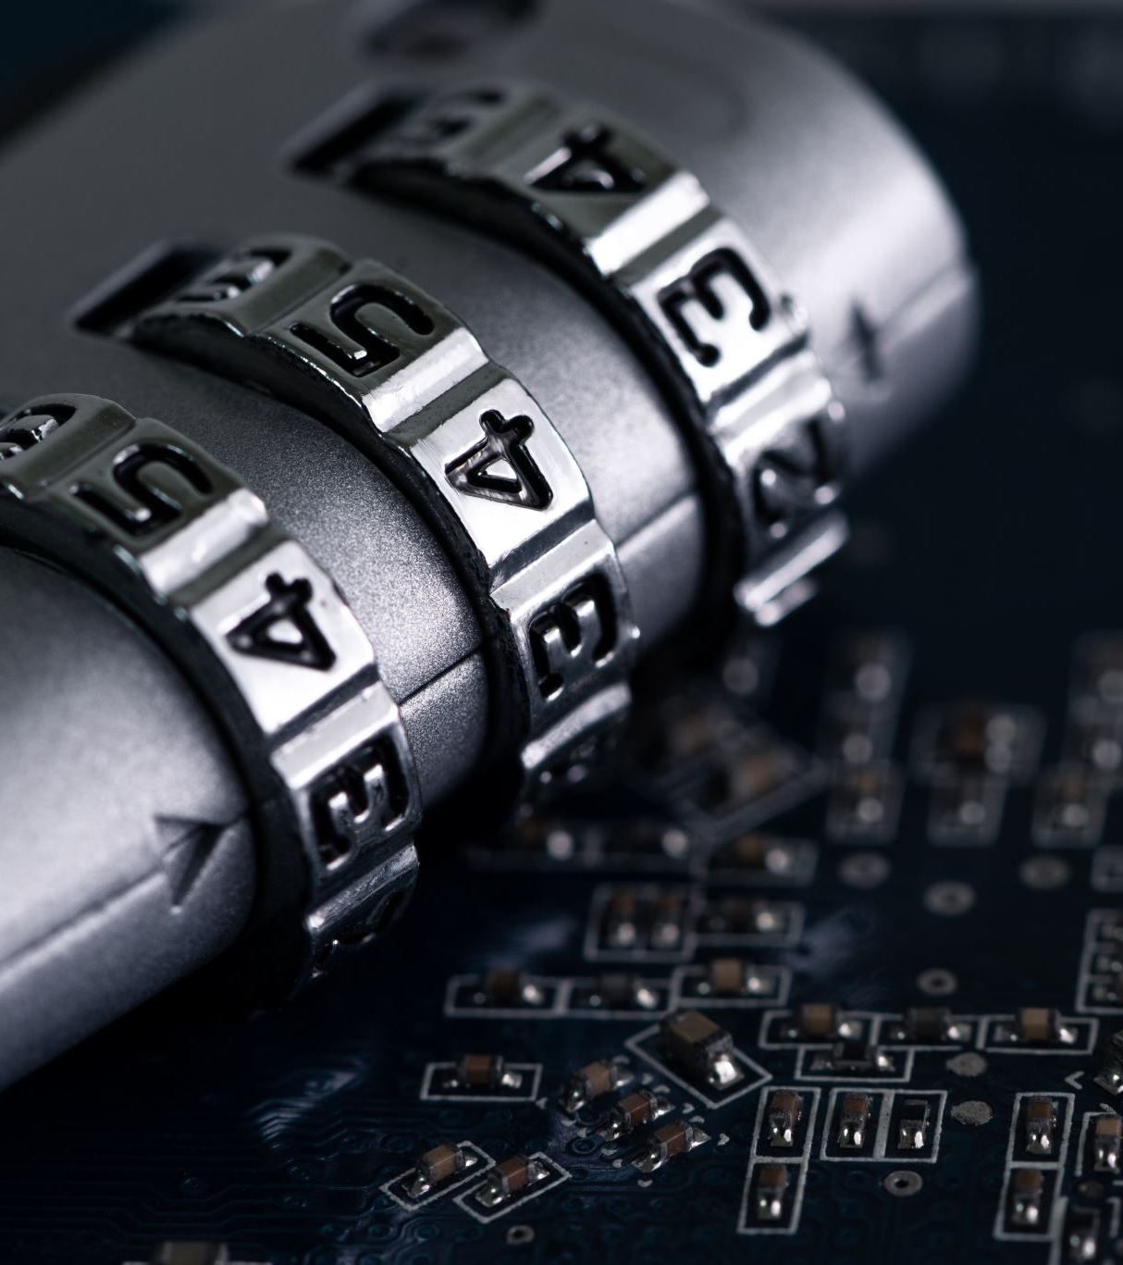
Idea
Shareable Smart Lock
Motivation: Locks are used everywhere but they are often primitive. In a world changing by the advancement of technology, locks must also change. We offer a smart lock solution that allows to easily lock/unlock by the swing of a smartphone so that there are no longer need to carry physical keys. This smart lock also revolutionizes the world of locks by offering a solution that simplifies the sharing of access while ensuring data privacy and security.

Slide 3

Core Features
SMART LOCKING MECHANISM (via NFC)
SHARE THE LOCK WITH DIGITAL TOKENS
CONTROL ACCESS RIGHTS
MONITOR LOCK HISTORY

Slide 4
Optional Features
LOCATION TRACKING (VIA GPS)
ALSO CONTROLLABLE BY PHYSICAL KEY

Slide 5
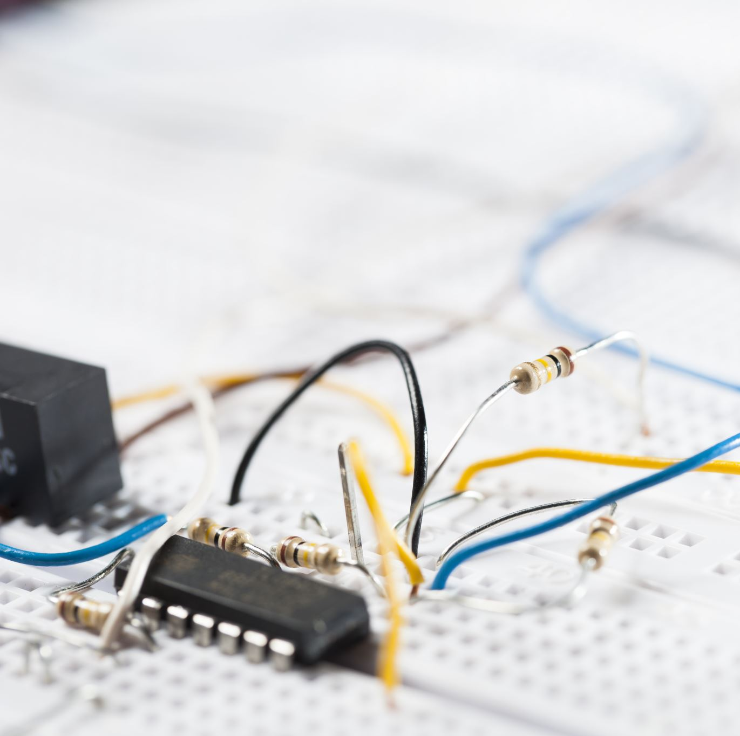
Hardware
Heltec WiFi LoRa 32 (V3)
PN532 (as NFC reader)
Servo motor and small metal pipe (for the physical lock)
Rechargeable battery (capacity will be determined later)
A small button (to wake the screen)

Slide 6
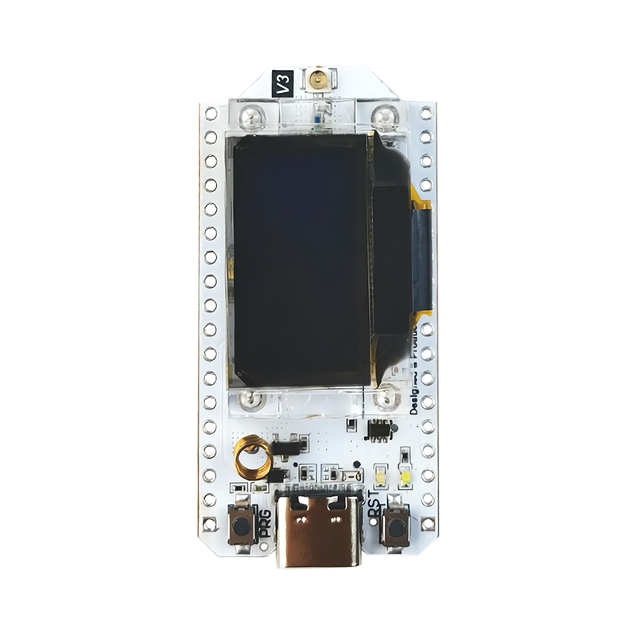
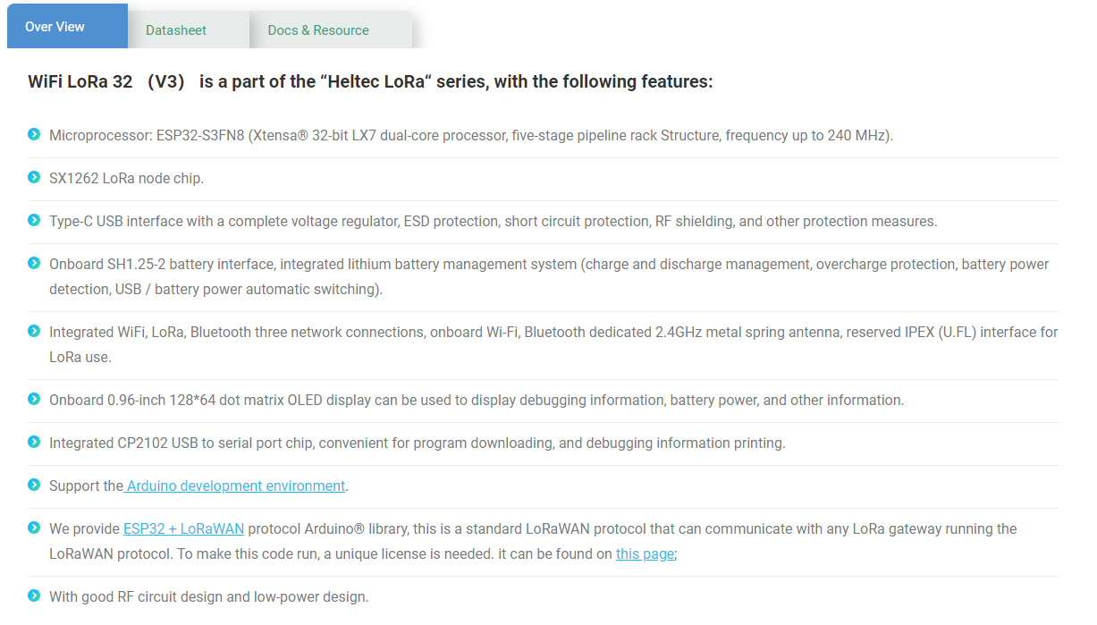
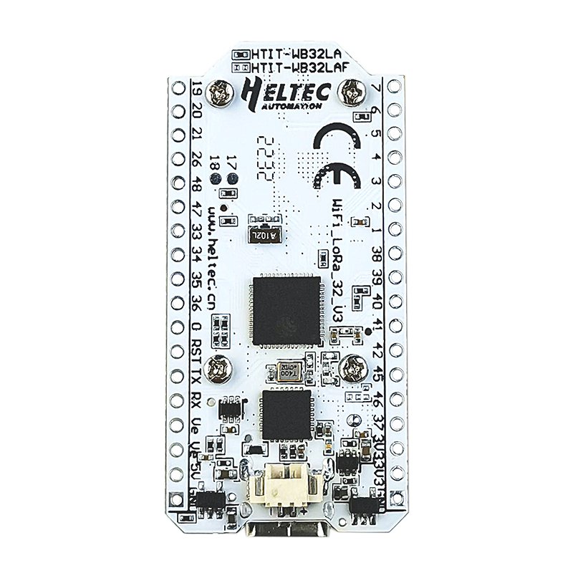
Heltec WiFi LoRa 32 (V3)

Slide 7
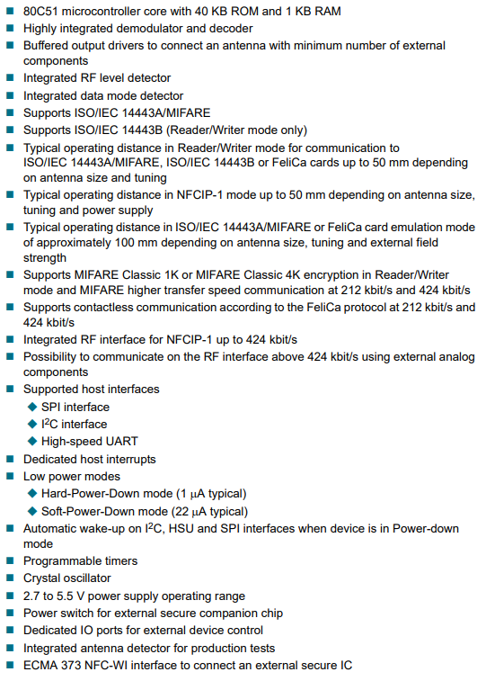
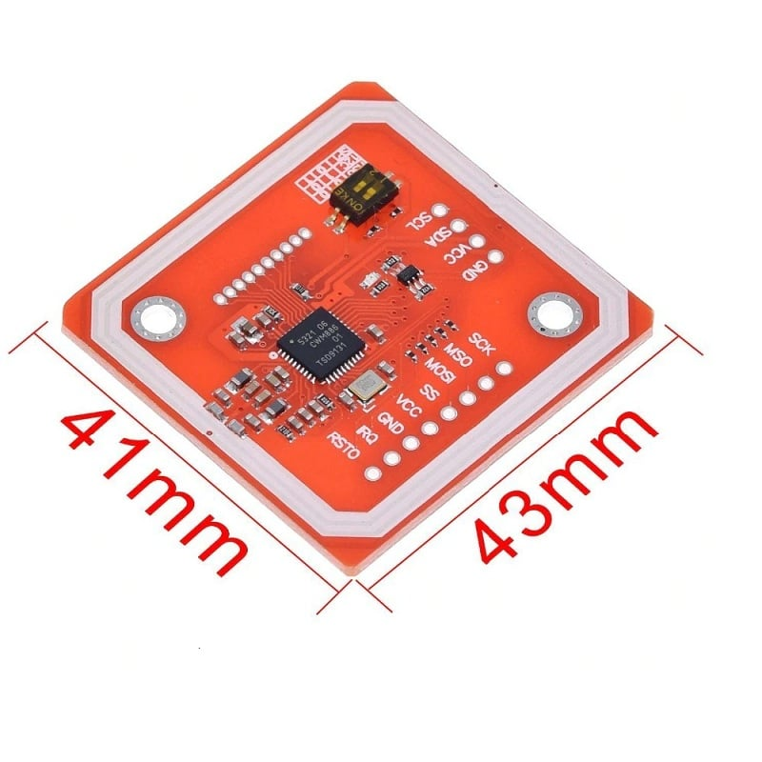
PN532

Slide 8
Typical Scenario
When a smart lock is produced, a token is generated and stored both in the lock and in our databases
When a user buys the lock, he/she can observe the token displayed on the screen upon pushing the wake-up button
The user enters the token in the app and thus the lock and the user account is linked (this user is now the admin of the lock)
Whenever the user puts his smartphone near the lock, the lock sends a request to the server (via LoRa)
The server checks if the NFC data of the smartphone matches the data in the database and replies with successful message
The lock is locked if already unlocked and unlocked if already locked
The token is now consumed by the smart lock and it only displays the battery level when waked-up

Slide 9
Lock Sharing Scenario
The admin user adds a new user for the lock through the mobile app
A new token is automatically generated for the new user
The admin user can share the token with whomever he/she wishes
The new user can use the token to link his/her account with the lock
The admin user can manage the rights of this user
Whenever the new user tries to lock/unlock the lock, the server checks if the NFC data matches and if the user has the necessary privileges

Slide 10

An estimation of the power consumption
Active State Power Consumption:
LoRa communication → 10-100 mA
NFC communication → 50 mA
Servo Motor → ~100 mA
Sleep Mode Power Consumption:
~10μA
If the lock is used 5 times a day, then
Daily Active Power Consumption (mAh) = ((100 mA+50 mA+100 mA)×0.00278 hours)×5 ≈ 1.388mAℎ×5 ≈ 6.94mAℎ
Daily Sleep Power Consumption (mAh)=10μA×24 hours×0.001 ≈ 0.240mAh
6.94 mAh+0.240 mAh ≈ 7.18 mAh per day
With Two AAA Batteries (Assuming 1000mAh capacity per AAA battery):
Battery Life (days)=Total Battery Capacity (mAh)Daily Power Consumption (mAh)Battery Life (days)=Daily Power Consumption (mAh)Total Battery Capacity (mAh)​
Battery Life ≈ 2000 mAh/(7.18 mAh/day) ≈ 278 days

